Slide 1



Dequeue Data structure

Slide 2

Definition
Dequeue(Double Ended Queue) is a specialized form of data structure Queue which consists with behaviors of both Queue(FIFO) and Stack(LIFO).Similar to the Queue front and rear are the both two active parts in Dequeue also. The main difference of Dequeue while comparing with Queue is, Serve and Append operations can be performed from both front and rear.

Slide 3


Introduction
Deques are a versatile data structure that can be used in a variety of applications. They are particularly useful in applications where elements need to be added or removed from both ends of the data structure.

Slide 4
Here there are two special types of Dequeues
1. Input Restricted Dequeue
Input restricted means elements can be inserted to the queue by either front or rear but not both but deletion can be done by both ends.
2. OUTPUT Restricted dequeue
Output restricted means elements can be deleted from the queue by either front or rear but not both but insertion can be performed by both ends.

Slide 5
Applications
Queues: Deques can be used to implement queues. In a queue, elements are added to the rear of the queue and removed from the front of the queue
Stacks: Deques can be used to implement stacks. In a stack, elements are added to the top of the stack and removed from the top of the stack
Undo operations: Deques can store a list of undo operations. This can be useful in applications where users can change data and then want to undo those changes
BFS: Deques can be used to implement breadthfirst search (BFS). BFS is a graph traversal algorithm that visits all the nodes in a graph in a breadth-first order
Caching: Deques can be used to cache frequently accessed data. This can improve the performance of applications by reducing the number of times that data needs to be retrieved from slower storage devices

Slide 6
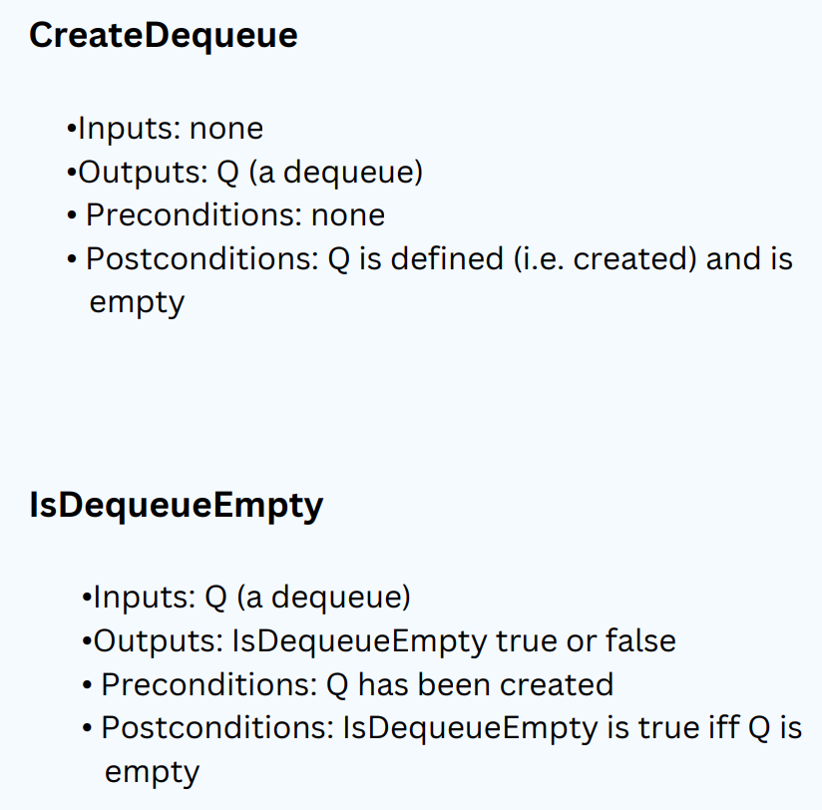
OPERATION SPECIFICATION

Slide 7
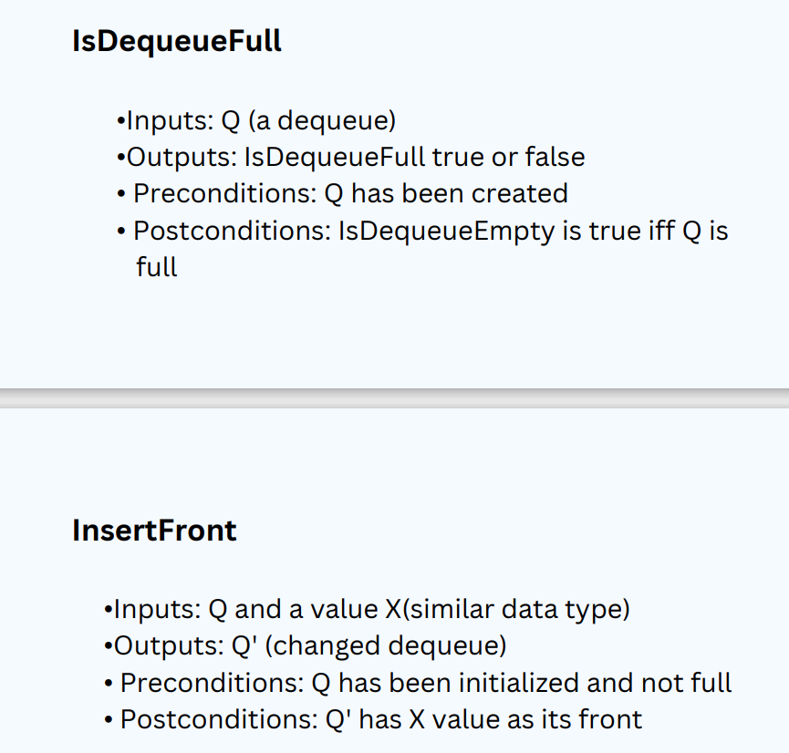
OPERATION SPECIFICATION

Slide 8
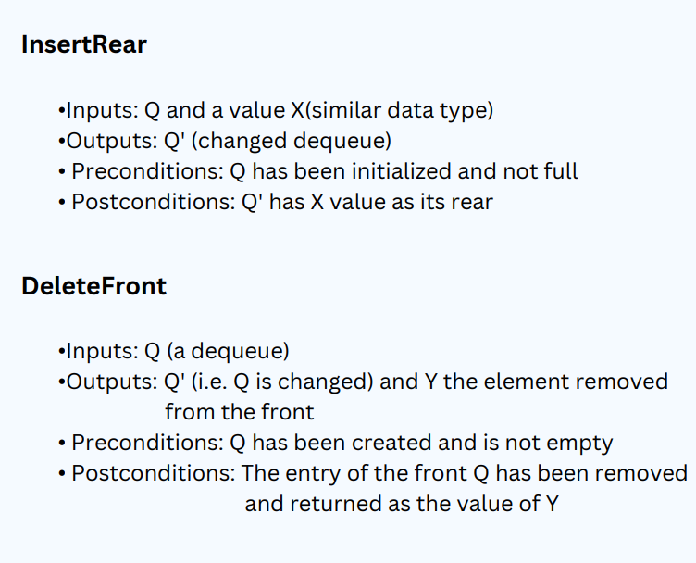
OPERATION SPECIFICATION

Slide 9
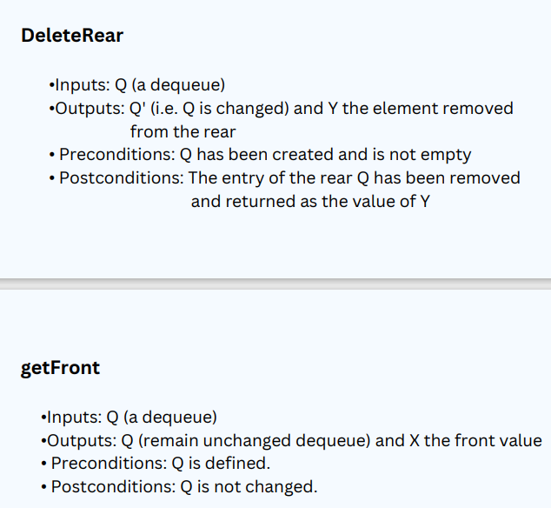
OPERATION SPECIFICATION

Slide 10
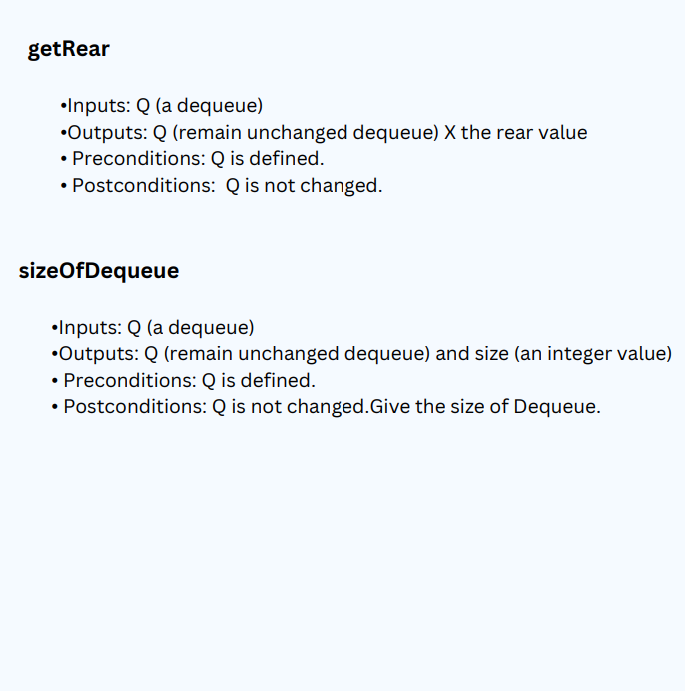
OPERATION SPECIFICATION

Slide 11

Contiguous implementation

Slide 12
Create Dequeue
public class Dequeue {
private int front;
private int rear;
int maxSize;
int count;
int dequeue[];
public Dequeue(int size) {
maxSize = size;
dequeue = new int[maxSize];
front = -1;
rear = -1;
count = 0;
}
}

Slide 13
Check Dequeue is empty
public boolean IsDequeueEmpty() {
return (front == -1) && (rear == -1) ;
}
Check Dequeue is full
public boolean IsDequeueFull() {
return (front == rear + 1)||
(front == 0 && rear == maxSize-1);
}
Size of the Dequeue
public void size() {
System.out.println("Dequeue size is: " + count);
}

Slide 14
Insert Front
public void InsertFront(int data) {
if(IsDequeueFull()) {
System.out.println("Dequeue is Full");
} else if (IsDequeueEmpty()) {
front = 0;
rear = 0;
dequeue[front] = data;
count++;
} else if (front == 0) {
front = maxSize - 1;
dequeue[front] = data;
count++;
}else {
front--;
dequeue[front] = data;
count++;
} }
F-Front
R-Rear
F
R
F
R
F
R
F
F
F
R

Slide 15
F-Front
Insert Rear
public void InsertRear(int data) {
if(IsDequeueFull()){
System.out.println("Dequeue is full.");
} else if (IsDequeueEmpty()) {
front = rear = 0;
dequeue[rear] = data;
count++;
} else {
rear = (rear + 1) % maxSize;
dequeue[rear] = data; count++;
} }
R-Rear
F
R
F
R
R
F
R
F
R
R

Slide 16
F-Front
Delete Front
public int DeleteFront() {
int delete;
if(IsDequeueEmpty()) {
System.out.println("Dequeue is empty.");
return 0;
} else if (front == rear) {
delete = dequeue[front];
front = rear = -1;
count--;
return delete;
} else {
delete = dequeue[front];
front = (front + 1) % maxSize;
count--;
return delete; } }
R-Rear
F=R=-1
F=R=-1
F
R
F
F
R
F
R
F

Slide 17
Delete Rear
public int DeleteRear(){
int delete;
if (IsDequeueEmpty()){
System.out.println("Dequeue is empty.");
return 0;
} else if (front == rear) {
delete = dequeue[rear];
front = rear = -1;
count--;
return delete;
} else if(rear == 0) {
delete = dequeue[rear];
rear = maxSize - 1;
count--;
return delete;
} else {
delete = dequeue[rear];
rear = rear - 1;
count--;
return delete;
} }
F-Front
R-Rear
F=R=-1
F=R=-1
F
R
R
F
R
F
R
R

Slide 18
Get Front
public void getFront() {
if(IsDequeueEmpty()){
System.out.println("Dequeue is Empty.");
}else {
System.out.print("Front element is: " +dequeue[front]);
} }
Get Rear
public void getRear() {
if(IsDequeueEmpty()) {
System.out.println("Dequeue is Empty.");
}else {
System.out.print("Rear element is:"+dequeue[rear]);
} }
F
5
1
8
3
9
R
5
F
5
1
8
3
9
R
9

Slide 19
Linked implementation

Slide 20
Node Class
public class Node {
int data;
Node next;
Node prev;
public Node(int data) {
this.data = data;
this.next = null;
this.prev = null;
}
}
Create Dequeue
public class Dequeue {
private Node front;
private Node rear;
private int dequeueSize;
public Dequeue(){
front = null;
rear = null;
dequeueSize = 0;
}

Slide 21
IsDequeueEmpty
public boolean IsDequeueEmpty(){
return dequeueSize == 0;
}
Get Front
public int getFront(){
if(IsDequeueEmpty()){
System.out.println("Dequeue is empty.");
return -1;
}else{
return front.data;
}
}
Size of Dequeue
Get Rear
public int getRear(){
if(IsDequeueEmpty()){
System.out.println("Dequeue is empty.");
return -1;
}else{
return rear.data;
}
}
public void size(){
System.out.println("Dequeue size is: "+dequeueSize);
}

Slide 22
Insert Front
public void InsertFront(int item) {
Node newNode = new Node(item);
if(newNode == null){
System.out.println("Out of the memory space");
}
else if (IsDequeueEmpty()) {
front = rear = newNode;
dequeueSize++;
} else {
newNode.next = front;
front.prev = newNode;
front = newNode;
dequeueSize++;
}
}
F
R
null
null
previous
null
10
F
null
R
null
null
next
previous
previous
previous
F
10
10
null
20
null
R
null
null
next
next
next

Slide 23
Insert Rear
public void InsertRear(int item) {
Node newNode = new Node(item);
if(newNode == null){
System.out.println("Out of the memory space");
}
else if (IsDequeueEmpty()) {
front = rear = newNode;
dequeueSize++;
} else {
rear.next = newNode;
newNode.prev = rear;
rear = newNode;
dequeueSize++;
}
}
F
R
null
null
10
F
null
R
null
previous
previous
F
null
10
20
R
null
next
next

Slide 24
Delete Front
public int DeleteFront() {
if (IsDequeueEmpty()) {
System.out.println("Dequeue is empty.");
return -1;
} else if(front == rear){
int removed = front.data;
front = rear = null;
dequeueSize--;
return removed;
}else {
int removed = front.data;
front = front.next;
front.prev = null;
dequeueSize--;
return removed;
} }
F
R
removed
10
null
null
previous
previous
previous
10
10
null
10
F
null
null
R
null
null
null
removed
null
next
next
next
next
10
next
F
null
10
20
R
null
next
null

Slide 25
Delete Rear
public int DeleteRear() {
if (IsDequeueEmpty()) {
System.out.println("Dequeue is empty.");
return -1;
}else if (front == rear) {
int removed = rear.data;
front = rear = null;
dequeueSize--;
return removed;
}else{
int removed = rear.data;
rear = rear.prev;
rear.next = null;
dequeueSize--;
return removed;
} }
F
R
removed
10
null
null
previous
null
10
F
null
null
R
null
null
null
removed
next
10
previous
previous
previous
F
10
10
null
20
null
R
null
null
next
next
next

Slide 26

Thankyou

